Slide 1
Air Quality Prediction in Smart Cities Using
Machine learning
UNDER THE GUIDANCE OF:
R.Veeramohana Rao, Asst. Professor
BATCH-C7:
R.Bindusri (Y20ACS540)
P.Pooja (Y20ACS529)
Sk.Aiman Sabaha (Y20ACS560)
R.Pattabhi Ramulu Guptha (Y20ACS549)

Slide 2
CONTENTS
Abstract
Existing System
Proposed System
Hardware and Software Requirements
Design and implementation
Result
Conclusion
References

Slide 3
ABSTRACT
Monitoring and preserving air quality has become one of the most essential activities in many urban areas today.
The quality of air is adversely affected due to various forms of pollution caused by transportation, electricity, fuel uses etc.
We must create better air quality prediction models to track pollutant levels and assess pollution in different areas due to rising air pollution.
The algorithms in the existing system have a longer execution time and less accuracy, which may limit its suitability and efficiency for certain real-world applications where time is crucial.

Slide 4
EXISTING SYSTEMS
Random forest regression is a powerful machine learning technique used for regression tasks, where the goal is to predict a continuous target variable. It belongs to the ensemble learning methods, which combine multiple individual models to improve predictive performance.
Linear regression is one of the simplest and most widely used statistical techniques for modeling the relationship between a dependent variable (also called the target or response variable) and one or more independent variables (also called predictors or features).
Decision tree regression is a machine learning algorithm used for regression tasks, where the goal is to predict a continuous target variable. It's a type of decision tree algorithm adapted for regression rather than classification.

Slide 5
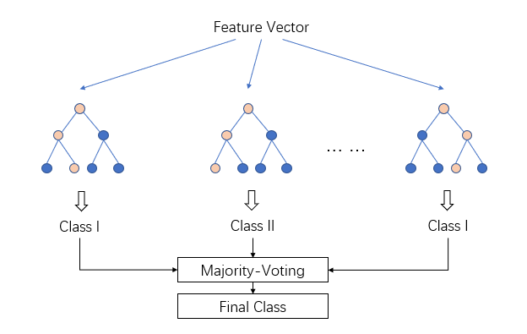
PROPOSED SYSTEMS
Light Gradient Boosting Machine
Light Gradient Boost is a gradient boosting framework developed by Microsoft that is known for its efficiency, speed, and high performance in handling large-scale datasets.

Slide 6
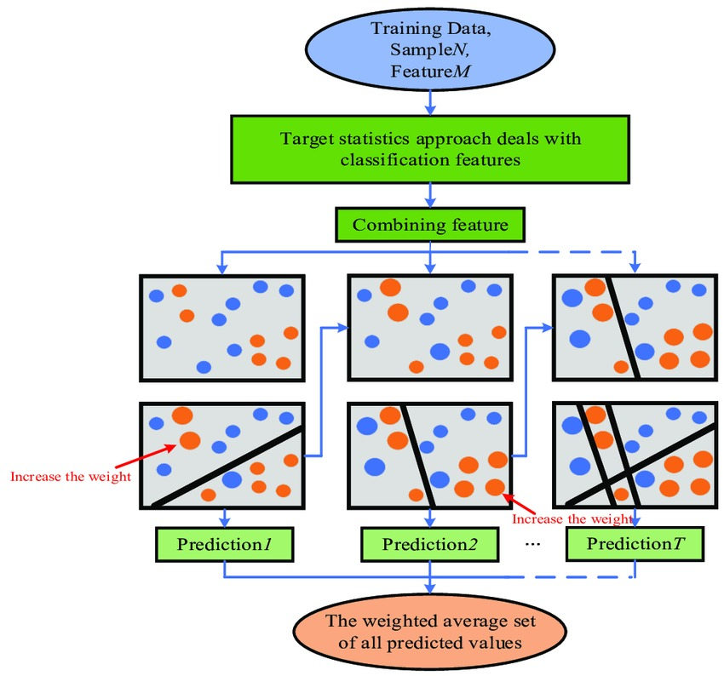
CatBoost
CatBoost is a high-performance open source library for gradient boosting on decision trees. It stands for "Categorical Boosting," emphasizing its ability to efficiently handle categorical variables without the need for extensive preprocessing.

Slide 7
Advantages of Proposed systems :
It increases the accuracy.
It reduces the time complexity.
It provides better information on features.

Slide 8
HARDWARE AND SOFTWARE REQUIREMENTS
Hardware requirements :
Processor : Inter Core i7
RAM : 16GB
Hard Disk : 256GB
Operating System : windows 11
Software requirements :
Coding Language : Python
Platform : Visual Studios
GUI Interface : flask

Slide 9
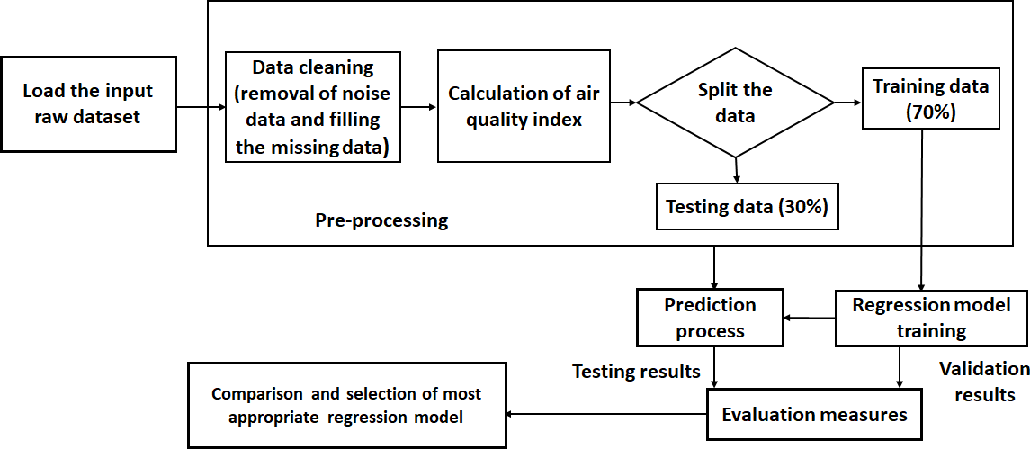
DESIGN

Slide 10
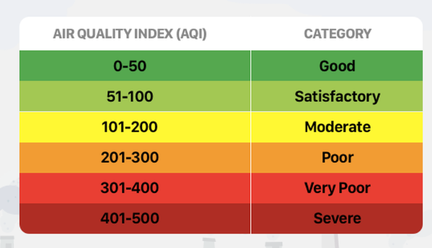

Slide 11
Here we have explored diverse machine-learning approaches for predicting air quality and air pollution in smart cities.
Additionally, investigating the effect of meteorological data, including temperature, pressure, humidity, and wind speed, further enhances AQI and air pollution prediction accuracy.
Reducing the execution time of models help to achieve more efficient machine learning models.

Slide 12
IMPLEMENTATION
Import all the necessary packages
Getting and performing data cleaning
Loading dataset for Training the model
Splitting data for Training and Testing
Training Section
Testing the model
Predictions and calculating Accuracy Metrics

Slide 13
RESULT
DATASET :
Dataset is a collection of data for analytics and prediction purposes.
This dataset has been collected from kaggle.
This dataset consists of 20 features.

Slide 14
Accuracy Values
For Existing Systems :
Decision Tree – 82%
Random Forest – 91.2%
Linear Regression – 79%
For Proposed Systems :
Cat Boost Regression – 91.6%
Light Gradient Boosting Machine – 91.3%

Slide 15
CONCLUSION
Our machine learning project aimed at predicting air quality, both CatBoost and Light Gradient Boost algorithms offer strong,accurate and efficient modeling.
CatBoost has the ability to handle categorical variables without extensive preprocessing makes it particularly well-suited for datasets with diverse feature types.
Light gradient boost is speed and scalable which makes it a convincing choice for large-scale datasets commonly encountered in air quality prediction projects.

Slide 16
REFERENCES
S. Ameer, M. A. Shah, A. Khan, H. Song, C. Maple, S. U. Islam, and M. N. Asghar, ‘‘Comparative analysis of machine learning techniques for predicting air quality in smart cities,’’ IEEE Access, vol. 7, pp. 128325–128338, 2019.
M. Batty, K. W. Axhausen, F. Giannotti, A. Pozdnoukhov, A. Bazzani, M. Wachowicz, G. Ouzounis, and Y. Portugali, ‘‘Smart cities of the future,’’ Eur. Phys. J. Special Topics, vol. 214, no. 1, pp. 481–518, Nov. 2012

Slide 17
THANK YOU

